Slide 1

CYCLONE ANALYSIS OF ODISHA
CE-594 , GEOHAZARD SCIENCE AND ENGINEERING
Department of Civil Engineering,
IIT Guwahati
By ,
Srimaya Mohapatra , 244104010

Slide 2
Cyclones in Odisha
Geographical Context:
Odisha lies on the eastern coast of India, adjacent to the Bay of Bengal—a region highly prone to tropical cyclones.
Historical Vulnerability:
The state has experienced frequent and intense cyclones, including devastating events like:
Super Cyclone (1999)
Cyclone Phailin (2013)
Cyclone Fani (2019)
Cyclone Yaas (2021)
Key concerns include:
High population density in coastal areas
Significant agricultural and infrastructural exposure
Rising frequency and intensity of cyclones due to climate change
Role of Data Analysis & Visualization:
Helps in Understanding cyclone patterns and trends
Enhancing early warning systems
Supporting disaster preparedness and mitigation

Slide 3
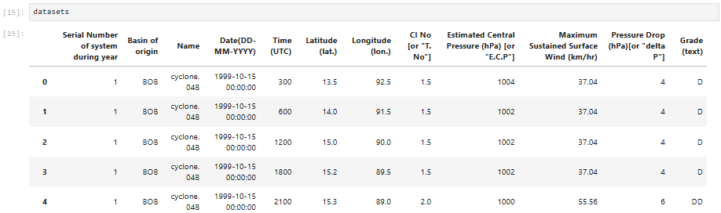
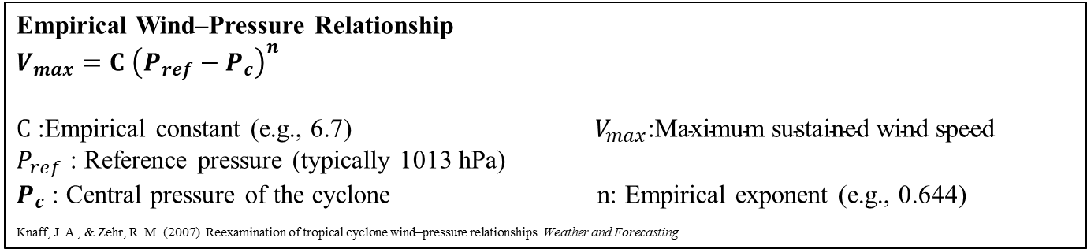

Methodology
Mean Squared Error (MSE)
$$MSE =1/n\sum_{i=1}^{r}{{\left(y_{R}−y_{A}\right)}^{2}}$$
2. Root Mean Squared Error (RMSE)
$$RMSE =\sqrt{1/n\sum_{i=1}^{r}{{\left(y_{R}−y_{A}\right)}^{2}}}$$
3. Coefficient of Determination (R²)
$$R^{2}=1−\frac{Σ_{i=1}^{n}{\left(y_{R}−y_{A}\right)}^{2}}{Σ_{i=1}^{n}{\left(y_{R}−\overline{y}R\right)}^{2}}$$
Wei, M., Fang, G., Nikitas, N., & Ge, Y. (2024). Machine-learning-based tropical cyclone wind field model incorporating multiple meteorological parameters
Empirical Wind–Pressure Relationship
$V_{max}=C$ ${\left(P_{ref}−P_{c}\right)}^{n}$
$C$ :Empirical constant (e.g., 6.7) $V_{max}\text{:}\text{Maximum} \text{sustained} \text{wind} \text{speed}$
$P_{ref}$ : Reference pressure (typically 1013 hPa)
$P_{c}$ : Central pressure of the cyclone n: Empirical exponent (e.g., 0.644)
Knaff, J. A., & Zehr, R. M. (2007). Reexamination of tropical cyclone wind–pressure relationships. Weather and Forecasting

Slide 4
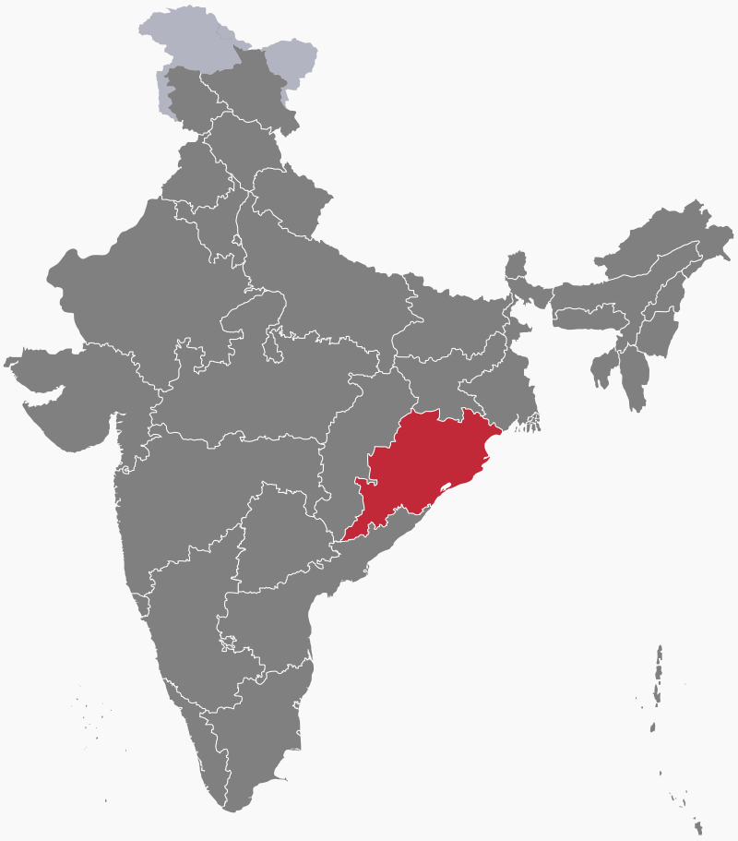
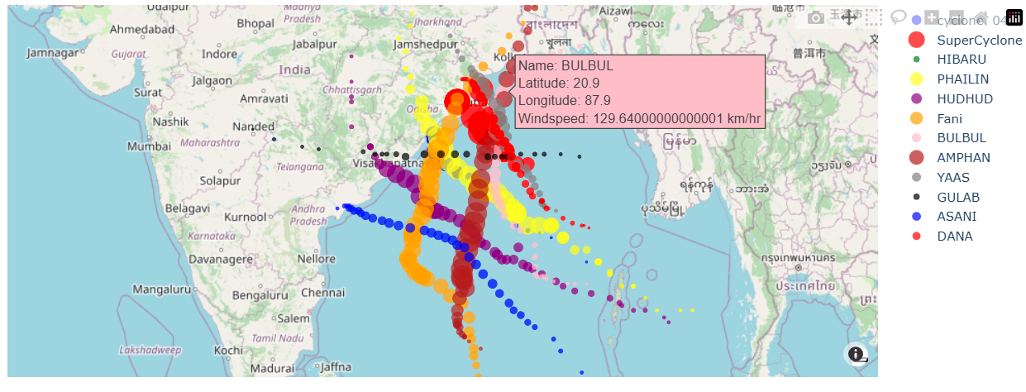
Study Areas

Slide 5
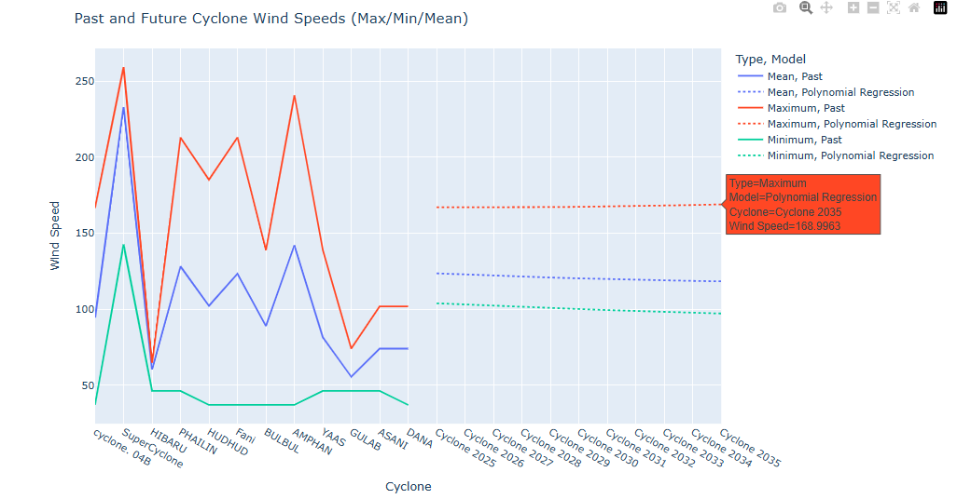
Cyclone Trend
The graph shows cyclone wind speed trends with polynomial regression forecasts (2025–2035).
Past data shows high variability, with peaks during Super Cyclone, Phailin, and Amphan.
Future projections suggest stabilization, with maximum wind speeds leveling around 169 km/h, and mean/minimum values remaining steady.
This indicates a potential steadying of cyclone intensity based on historical pressure and wind speed patterns.

Slide 6
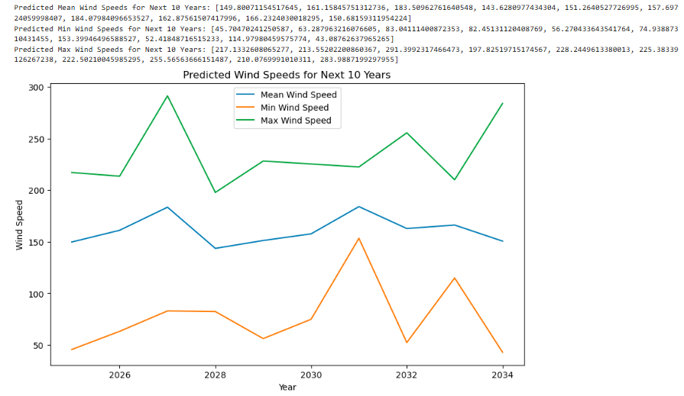
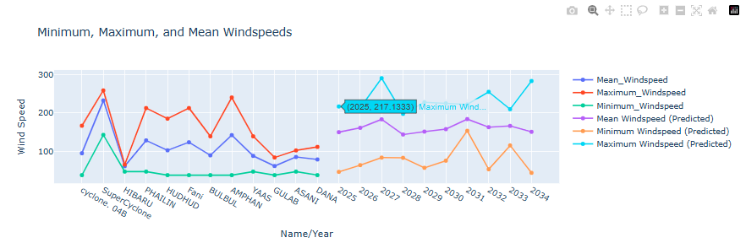

Future Cyclone Wind Speed Forecast (2025–2034)
$V_{max}=C$ ${\left(P_{ref}−P_{c}\right)}^{n}$
The graphs show predicted maximum, mean, and minimum wind speeds for cyclones from 2025 to 2034, based on historical data and regression modeling.
While past cyclones show large variations, future predictions indicate:
Maximum wind speeds may remain high but vary year to year, peaking around more than 200+ km/h.
Mean wind speeds are relatively steady, around 150–180 km/h.
Minimum wind speeds show moderate fluctuations, ranging from 25 to 100 km/h.
The forecast reflects a non-linear trend, capturing both stable and potentially extreme future cyclone events.

Slide 7
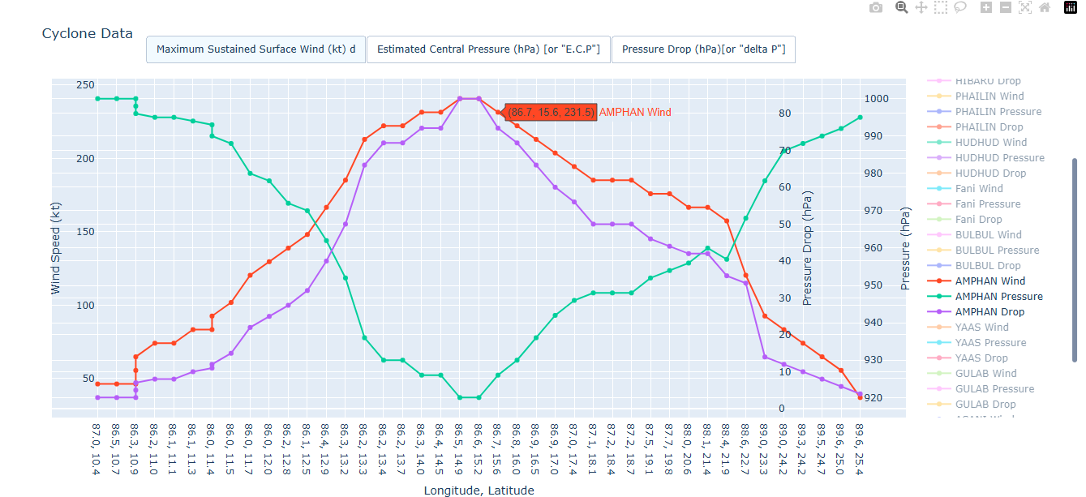
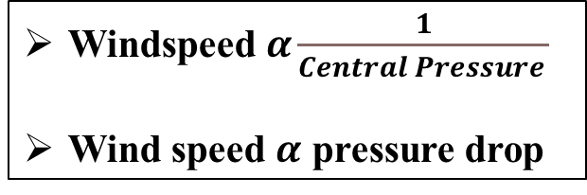
Wind Speed vs Pressure Dynamics
Windspeed $α\frac{1}{Central Pressure }$
Wind speed $α$ pressure drop
This graph illustrates the trajectory and intensity evolution of Cyclone Amphan.
As the cyclone intensified (left to right), wind speed increased while central pressure decrease significantly.
The strong direct correlation between wind speed and pressure drop (ΔP) confirms the empirical pressure–wind relationship.
These dynamics highlight the critical role of pressure data in estimating cyclone strength and forecasting landfall impacts.

Slide 8
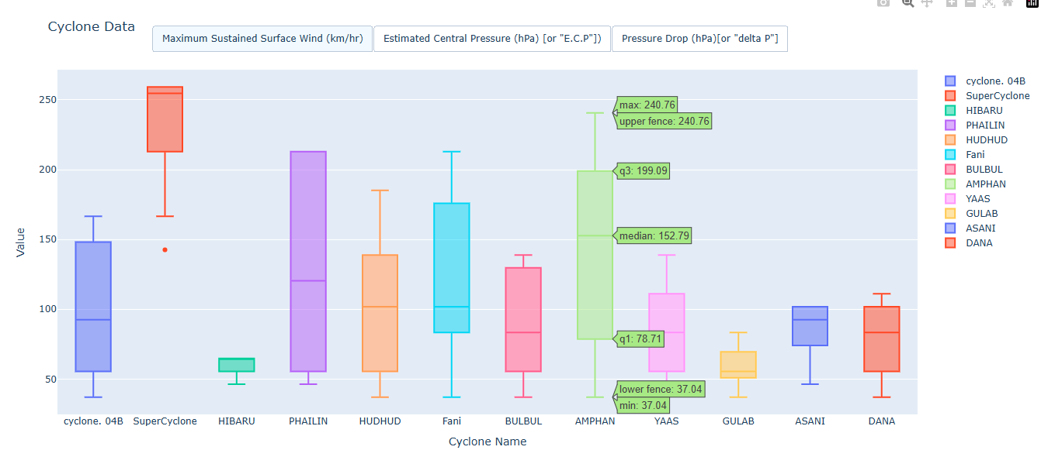
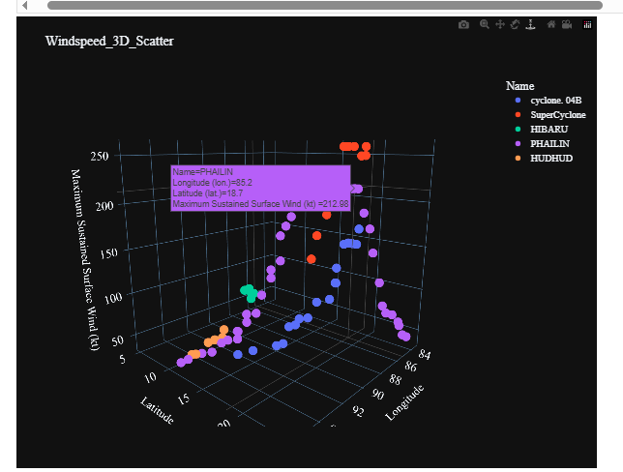
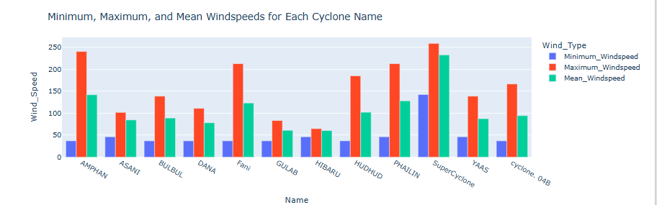
Other Plots

Slide 9
Conclusion
Accurate cyclone wind speed prediction is vital for risk management. Empirical models using pressure–wind relationships, especially those based on pressure drop and gradient wind balance, provide reliable estimates. By learning from historical data and accounting for cyclone structure, these models improve forecasting for future events.

Slide 10
Reference
Wei, M., Fang, G., Nikitas, N., & Ge, Y. (2024). Machine-learning-based tropical cyclone wind field model incorporating multiple meteorological parameters. Journal of Wind Engineering and Industrial Aerodynamics, 255, 105936.
Knaff, J. A., & Zehr, R. M. (2007). Reexamination of tropical cyclone wind–pressure relationships. Weather and Forecasting, 22(1), 71-88.

